Slide 1

1st Year PSTP (JAVA) — S10 Project
Academic Year 2026–2027
Car Rental Fleet Manager
Travel & Logistics Solutions | SDG 8: Decent Work & Economic Growth
Project Team Members
S.no | Roll Number | Student Name
1 | 2620080071 | Harish
2 | 2620030506 | Sabeer
3 | 2620040159 | KVS Karthik
Core System Focus
Object-oriented Java console manager handling fleet availability, polymorphic charging, maintenance locks, and state file persistence.
Course: Object Oriented Programming in Java

Slide 2

01. Operational Challenges
Problem Statement
Double-Booking Conflicts
Agencies lose track of reserved date windows, assigning active vehicles to multiple clients.
Business & SDG Impact
Untracked Fuel & Mileage
Without automated fleet tracking, rental agencies face reduced utilization, inaccurate billing, and safety non-compliance.
Check-out and check-in readings are unrecorded, leading to revenue loss on extra distance and fuel.
Goal: SDG 8 Target Promote sustained economic growth through tech-driven resource efficiency.
Service Oversight Hazards
Vehicles exceeding maintenance thresholds remain on the road, increasing breakdown risks.
Car Rental Fleet Manager
Slide 2 of 6

Slide 3



02. Architecture & Design
Core Solution & Domain Model
1. Abstract Base
2. Immutable Records
3. Central Logic
Vehicle Class
Rentals & Service
FleetManager
Encapsulates ID, rates, and odometer readings across fleet vehicles.
Stores customer dates, fuel levels, total fees, and maintenance history.
Coordinates availability, booking checks, billing calculation, and file persistence.
Economy | SUV | Luxury
Rental & ServiceRecord
Orchestrates System Operations
Car Rental Fleet Manager
Slide 3 of 6

Slide 4

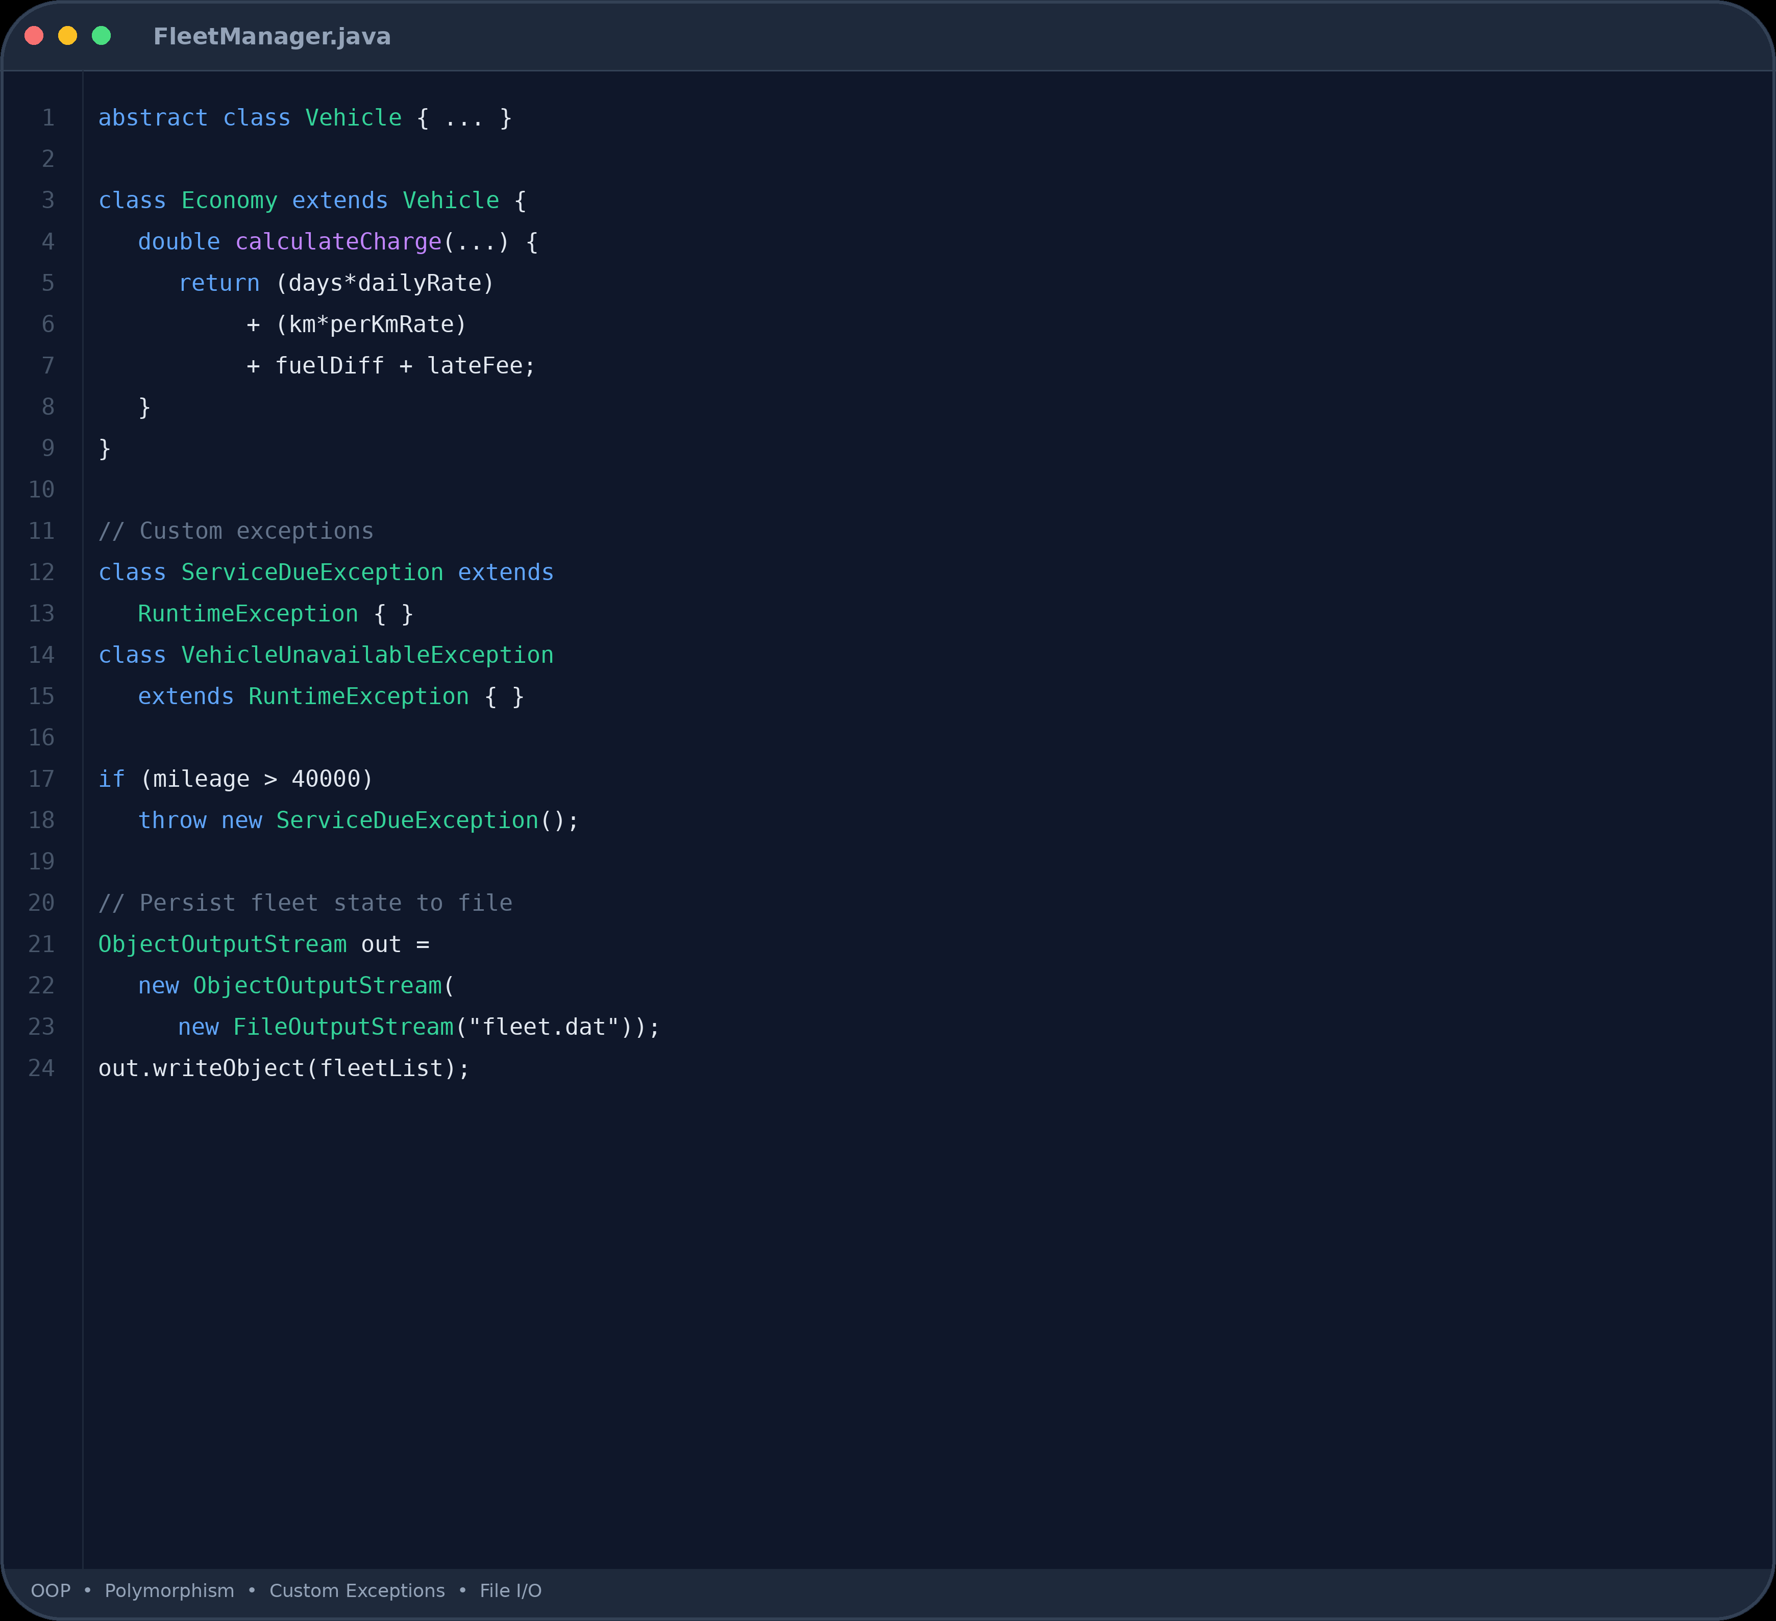
03. Technical Implementation
OOP Principles & System Rules
Polymorphic Charging Rule
total = (days * dailyRate) + (km * perKmRate) + fuelDiff + lateFee
Custom Exceptions
Vehicle Unavailable Exception
ServiceDueException
Throws and to enforce business rules.
File Persistence & Restoration
Saves fleet state, rentals, and service records to files; rebuilds availability grid on startup.
Car Rental Fleet Manager
Slide 4 of 6

Slide 5
04. Live Execution & Reports
Sample Run & Fleet Analytics
Java Streams Reporting
Sample Console Billing Walkthrough
KA09-SUV-3
• Rental Range: 2026-08-05 to 2026-08-08 (3 Days)
• Odometer: 41,230 → 41,710 km (480 km driven)
• Fuel Usage: 3/4 → 1/2 (Fuel Diff Fee = ₹600)
Utilisation Rate: Percentage computed per vehicle class
Revenue Streams: Grouped via
Collectors.groupingBy()
Service Flags: Filtered at 40,000+ km maintenance threshold
Charge: 3d × 2,500 + 480 × 8 + 600 = ₹11,880
Fleet Sorting: Comparative ranking using custom
Comparator
Car Rental Fleet Manager
Slide 5 of 6

Slide 6
05. Conclusion & Road Ahead
Summary & Stretch Goals
Core Deliverables Met
Future Stretch Goals
• Zero double-bookings across overlapping dates.
• One-way Rentals: Multi-branch relocation fee logic.
• Accurate duration, mileage, fuel & penalty charges.
• Predictive Maintenance: Mileage trend forecasting.
• Automatic service-due flagging & rental blocking.
• Damage Settlement: Digital damage-log deposit claims.
• Persistent state reloading matching original data.
• REST API / Web UI: Spring Boot & React dashboard.
Thank You — Q&A Session
Slide 6 of 6

Slide 7


Academic Year 2026–2027
Thank You!
Any questions about the Car Rental Fleet Manager system?
Harish (2620080071)
|
Sabeer (2620030506)
|
KVS Karthik (2620040159)
Car Rental Fleet Manager — Java PSTP Project
Q&A Session

